Slide 1
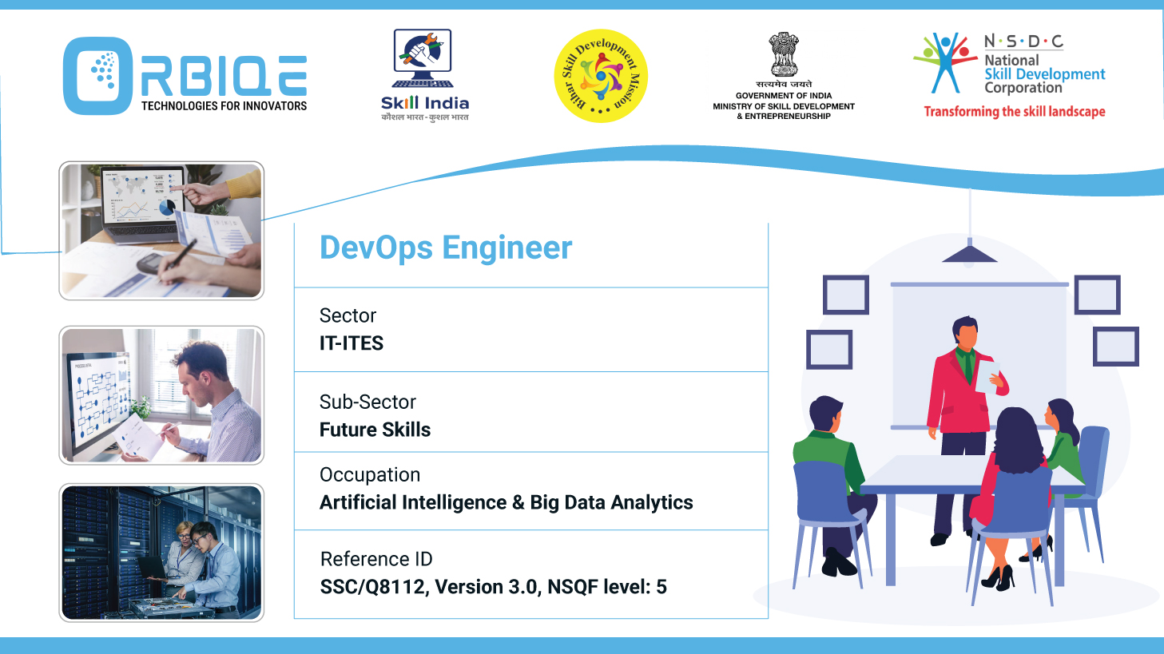
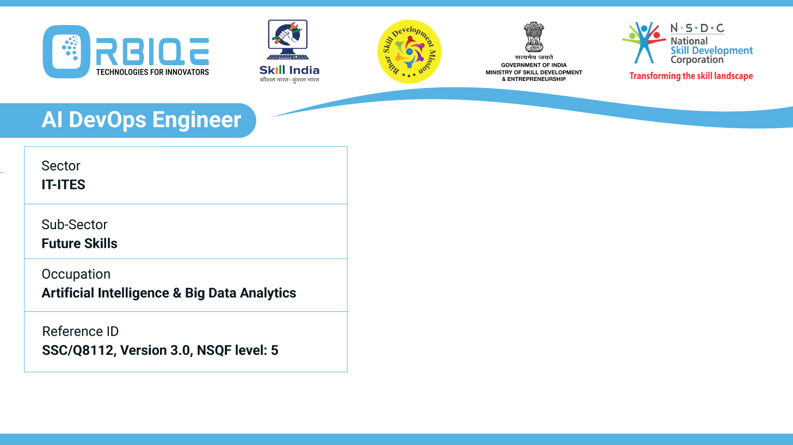
Name- Krishna Kant Dubey

Slide 2

Mastering Database Queries: Functions and Methods Unveiled

Slide 3
Agenda
Identify different functions and methods to query SQL/NoSQL databases, gaining proficiency in extracting and manipulating data efficiently
SQL Databases (e.g., MySQL, PostgreSQL)
NoSQL Databases (e.g., MongoDB, Redis, Cassandra)

Slide 4
SQL Databases
Purpose | SQL Syntax Examples
Select Data | SELECT * FROM Users WHERE age>30;
Join Tables | SELECT u.name, o.amount FROM Users u join Orders o
GROUP BY, HAVING: Aggregation | SELECT department, AVG(salary)FROM employees GROUP BY department HAVING AVG(salary) > 70000;
 | WITH recent_sales AS ( SELECT * FROM sales WHERE sale_date > '2025-08-01')SELECT * FROM recent_sales WHERE amount > 1000;

Slide 5
Advanced SQL Functions
Function Type | Examples | UseCase
Aggregate | SUM(),AVG(),COUNT() | Summarise Data
Window | ROW_NUMBER(),RANK() | Analyze data across partitions
String | CONCATE(),SUBSTRING() | Manipulate Text
Date/Time | NOW(),DATE_TRUNC() | Handle Timestamps
Conditional | CASE,COALESCE() | Add logic to queries

Slide 6
No SQL Databases
Document Stores (MongoDB, Couchbase)
Key-Value Stores (Redis, DynamoDB)
Columnar Stores (Cassandra, HBase)
Graph Databases (Neo4j)

Slide 7
Document Stores (MongoDB, Couchbase)
{field:{$eq:value}},{$in:[…]},{$regex:/pattern/}
Aggregation pipeline-$match, $group, $project,$sort,$limit

Slide 8
Key-Value Stores (Redis, DynamoDB)
Redis
GET, SET, SCAN, HGETALL
DynamoDB
Query, Scan, Getitem, Putitem

Slide 9
Columnar Stores (Cassandra, HBase)
Cassandra Query Language
SELECT, INSERT, UPDATE, DELETE
Hbase
hbase> scan 'table_name', { TIMERANGE => [start_timestamp, end_timestamp] }

Slide 10
Graph Databases (Neo4j)
Cypher Query Language
MATCH(n)->[r]->(m) RETURN n,r,m

Slide 11
Thank You

